Slide 1
Bankruptcy Prevention Project
Group 6

Slide 2
Mentor: karthik
TEAM MEMBERS
P.Pavani
Koti Ramesh
Mr.Pushpendra Singh Bhadauriya
Kartik Santosh Nanekar
Shaik MohammedAshraf

Slide 3
Introduction
Overview
Welcome Statement: Welcome, everyone, to my presentation on the Bankruptcy Prevention Project.
Purpose: The purpose of this project is to develop a predictive model that can assess the likelihood of a business going bankrupt.
Importance: Understanding and predicting bankruptcy is crucial for businesses and financial institutions to mitigate risks and make informed decisions.
This presentation will cover the project's business objective, data description, acceptance criteria, project milestones, and key findings.
.

Slide 4
Data Overview:
Industrial Risk: Categorical variable with values 0 (low risk), 0.5 (medium risk), and 1 (high risk).
Management Risk: Categorical variable with values 0 (low risk), 0.5 (medium risk), and 1 (high risk).
Financial Flexibility: Categorical variable with values 0 (low flexibility), 0.5 (medium flexibility), and 1 (high flexibility).
Credibility: Categorical variable with values 0 (low credibility), 0.5 (medium credibility), and 1 (high credibility).
Competitiveness: Categorical variable with values 0 (low competitiveness), 0.5 (medium competitiveness), and 1 (high competitiveness).
Operating Risk: Categorical variable with values 0 (low risk), 0.5 (medium risk), and 1 (high risk).
Class: Target variable with values 'bankruptcy' and 'non-bankruptcy'.

Slide 5
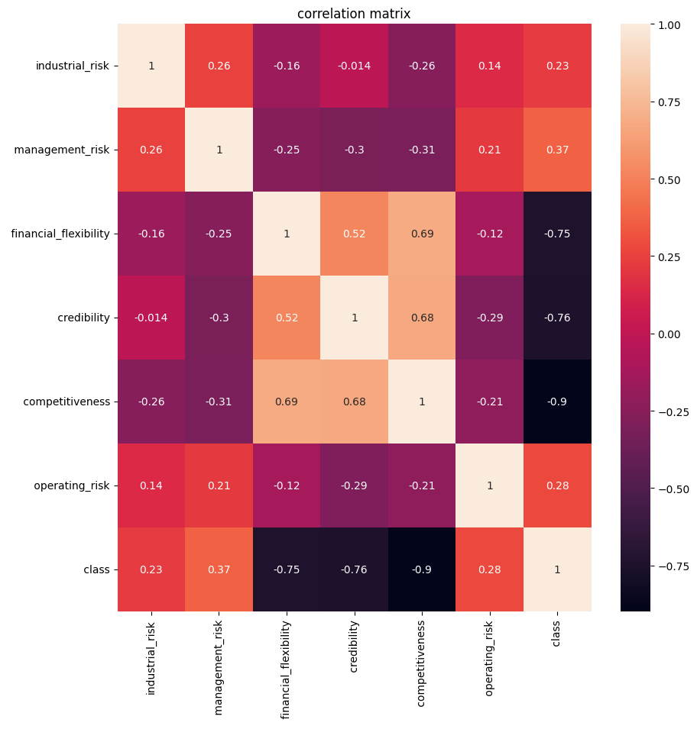
Objective
Daily price movements contain significant noise, indicating market volatility.
Techniques like moving averages help to smooth out noise for better trend visualization.
Correlation heatmap
Here we can see that the attribute “Competitiveness“ is highly correlated with the attributes “Financial Flexibility" and "credibility“

Slide 6
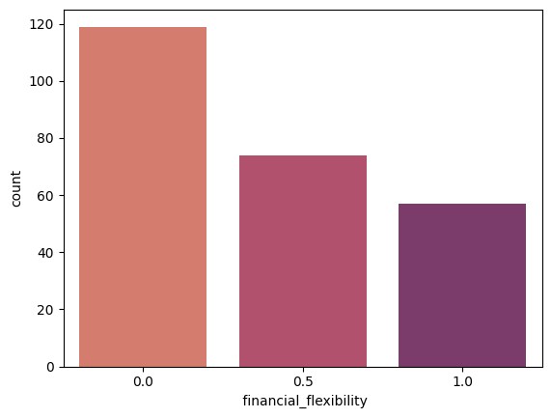
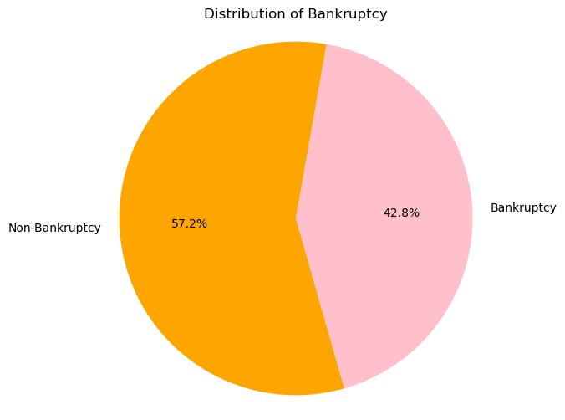
The Financial Flexibility Of The companies Are Good
Pie Chart Shows the number of bankrupt and non-bankrupt companies.

Slide 7
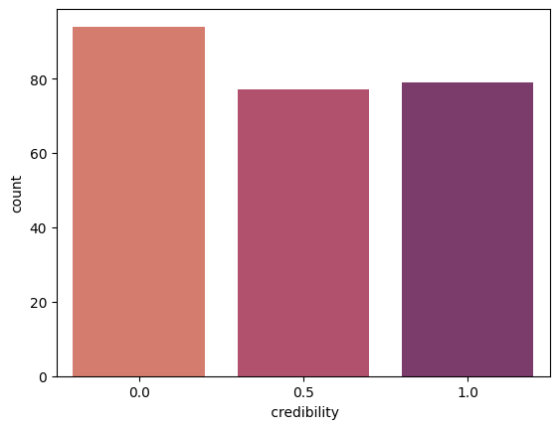
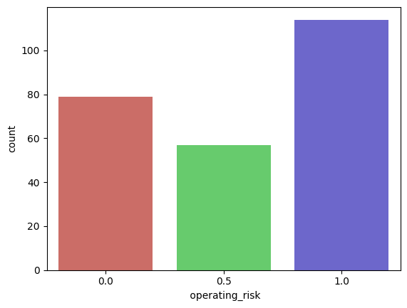
Their is some risk with the credibility of the companies risk percentage is almost equal
This plot shows that the companies operational processes has the higher chance for bankruptcy

Slide 8
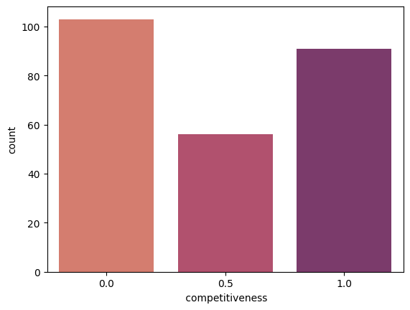
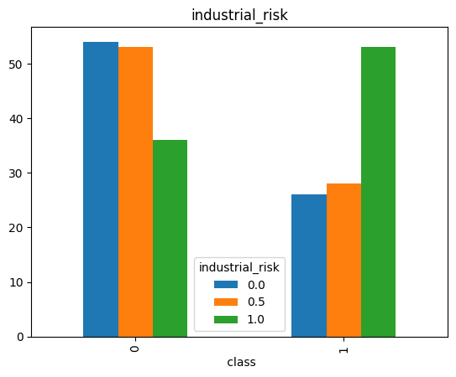
There is risk with the competitiveness of the company
The industrial risk is low in companies

Slide 9

Model Building

Slide 10


Bankruptcy Prevention Project
Logistic Regression
Random
Forest
Support
Vector
XG BOOST
Classification is based on the concept of Support Vector Machines, which are a set of supervised learning methods used for classification, regression, and outliers detection
Is a statistical method used for binary classification problems. It predicts the probability that a given input point belongs to a certain class.
is an ensemble learning method, which means it combines the predictions of multiple base learners to improve overall performance.
It is known for its performance and speed, making it a popular choice in competitive machine learning and practical applications.

Slide 11
SUPPORT VECTOR

Slide 12
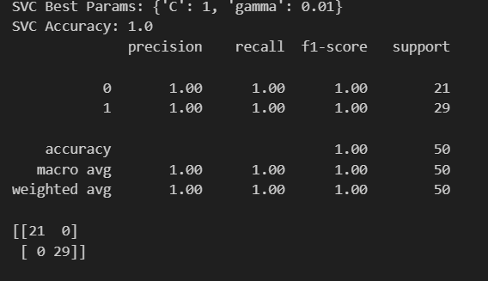
SUPPORT VECTOR
Model Results
Accuracy
1.0
Confusion matrix
[[21 0]
[ 0 29]] Classification Report

Slide 13
Logistic Regression

Slide 14
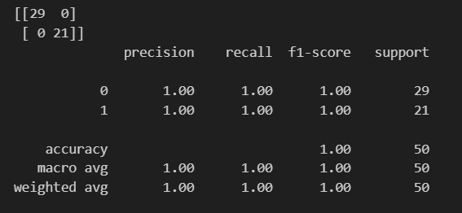
Logistic regression
Model Results
Accuracy
1.0
Confusion matrix
[[29 0]
[ 0 21]] Classification Report

Slide 15
Random forest classifier

Slide 16
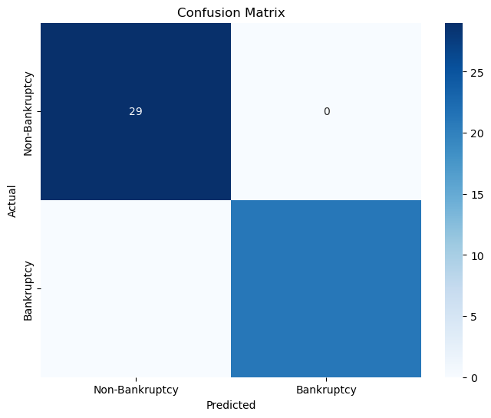
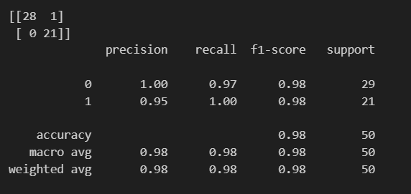
Random forest classifier
Model Results
Accuracy
0.98
Confusion matrix
[[28 1]
[ 0 21]] Classification Report

Slide 17
XG Boost CLASSIFIER

Slide 18
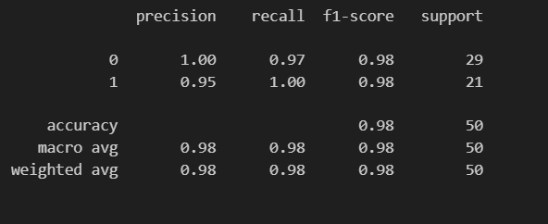

XG Boost classifier
Model Results
Accuracy
0.98
Confusion matrix
[[28 1]
[ 0 21]] Classification Report

Slide 19
Model Deployment
Logistic Regression

Slide 20
Deployment
Selected the Logistic Regression model with best performance.
Predict the probability of a business going bankrupt
create pipeline for Inferencing save model input feature and necessary Preprocessing steps
Deploy and export necessary file around readme file which will contain steps and procedure

Slide 21
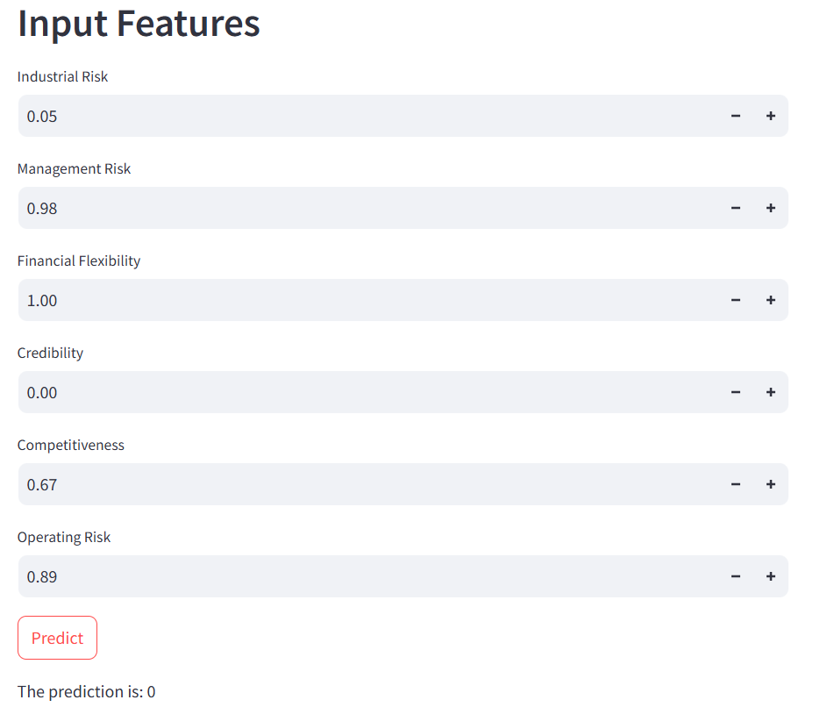
Deployment

Slide 22
Challenges of the Bankruptcy Prevention Project
Data Quality and Quantity:
Small Dataset: The dataset consists of only 250 companies, which is relatively small. This can lead to overfitting, where the model performs well on the training data but poorly on unseen data.
Class Imbalance: If the dataset has more non-bankruptcy cases than bankruptcy cases (or vice versa), it can lead to biased predictions. The model might predict the majority class more frequently, reducing its usefulness.
Feature Representation:
Categorical to Numerical Conversion: Converting categorical risk levels (e.g., low, medium, high) to numerical values while maintaining the ordinal nature of these categories can be challenging.
Feature Engineering: Identifying and creating new features that might help improve model performance. This requires domain knowledge and can be time-consuming.
Model Selection and Tuning:
Choosing the Right Model: Deciding on the appropriate machine learning algorithms to use (e.g., Logistic Regression, Random Forest, XGBoost) requires experimentation and understanding of the model's strengths and weaknesses.

Slide 23
Model Evaluation:
Evaluation Metrics: Selecting appropriate metrics (e.g., accuracy, F1 score, precision, recall) to evaluate model performance. In cases of imbalanced data, accuracy might not be the best metric.
Cross-Validation: Implementing cross-validation to ensure the model's performance is consistent across different subsets of the data. This helps in understanding the model's generalization capability.
Outlier Detection and Handling:
Outliers: Identifying and dealing with outliers in the dataset. Outliers can skew the results and affect the model's performance.
Deployment:
Integration: Integrating the model into a web application using frameworks like Flask or Streamlit. This requires additional skills in web development and API creation.
Scalability: Ensuring the deployed model can handle real-time predictions efficiently and can scale as needed.
Interpretability:
Model Explainability: Making the model's predictions understandable to non-technical stakeholders. This involves explaining how different features contribute to the prediction of bankruptcy.
Maintenance:
Model Updates: Regularly updating the model with new data to ensure it remains accurate and relevant over time.
Monitoring Performance: Continuously monitoring the model's performance post-deployment to detect and address any issues promptly.

Slide 24
THANK YOU

